Slide 1
Module 2.1 – Sensors and Actuators
Sonar, Accelerometer, Gyroscope

Slide 2
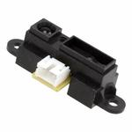
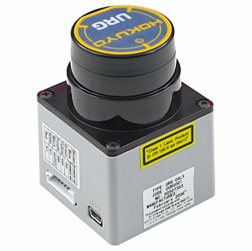
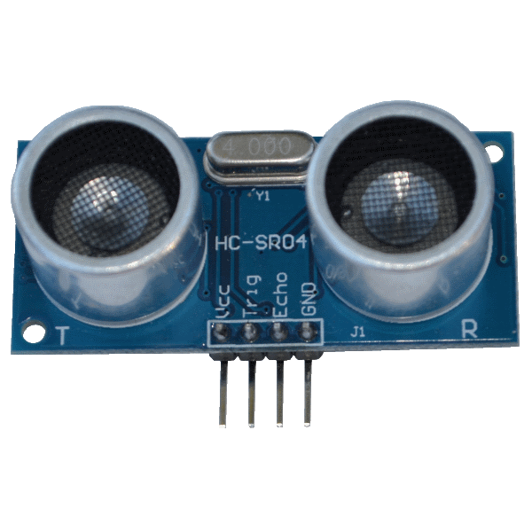
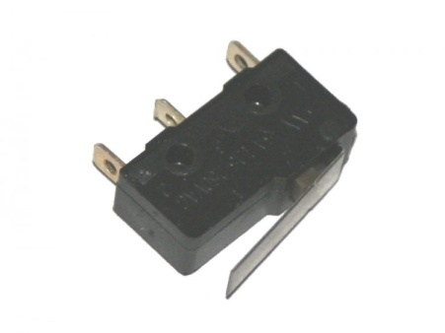
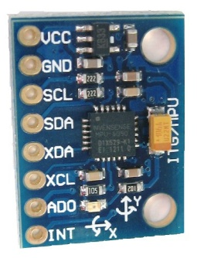
Types of Sensors
A Robot need sensors in order to react to the world around it
Types of Sensors
Range (Infrared, Sonar, Laser)
Contact (Bump Switch)
Motion (Accelerometer, Gyroscope)
Light, Sound
Visual (Camera)
Temperature
Notes:
In order for a robot to react to the world around it, it needs to have sensor readings
There are many different types of sensors and here are a few sensor categories
Ranging sensors are used to the read the distance to an object
Contact sensor detect if a robot has run into an object
Accelerometers and gyroscope measure orientation and motion
There are light and sound sensors
Cameras are used for computer vision applications
There are also sensors for measuring temperature

Slide 3
Sonar
Each type of ranging sensor has advantages and disadvantages
Standard infrared light sensors are low cost but can be too short range
Scanning lasers sensors are accurate but expensive
Thousand of dollars
‘Jet’ uses sonar modules
These provide good range (5m) at a low cost
Sonar modules send out a pulse of ultrasound (40KHz) and measure the time for the sound to reflect back
Notes:
Each of the types of ranging sensor has pros and cons
Infrared light sensors are quite inexpensive (~$10), but they often have limited range (Sharp IR sensors have a range of 1 meter)
Scanning lidar sensors give very accurate readings by measuring the time for light to reflect off an object, but the sensors can cost thousand of dollars
Jet uses sonar modules that send a pulse of ultrasound and measure the time it takes for the sound to reflect back to the sensor
These are the same type of sensors that are use in automobiles to detect nearby objects
Because these sensors use sound and the sound can disperse and reflect in different ways, it is not possible to trigger multiple sonar modules simulaneously

Slide 4
Sonar
The Jet sonar module is the HC-SR04
Range 2cm to 4m
4-pin interface
Vcc (5V)
GND (Ground)
Trig (Pulse to initiate measurement)
Echo (Measure pulse to get reading)
Notes:
Jet uses the HC-SR04 sonar module which provides ranging measurements up to 4m
The actual timing and hardware details have been abstracted out in the ROS operating system to make it easier to use
It is important though to remember the naming/purpose of each of the 4-pins when constructing the robot

Slide 5
Accelerometer
An accelerometer measures the orientation of an object relative to the earth gravitational field
Can also measure vibration
The orientation of an object can be determined by reading the accelerometer which provides reading for 3 axis (X, Y, and Z)
The GY-521 is the sensor that contains a 3-axis accelerometer and gyroscope on the Jet
Notes:
An accelerometer is a sensor which measures the orientation of a robot relative to the Earth’s gravitational field
This allows measurement of tilt and can also be used to measure vibration
The GY-521 is a 3-axis gyroscope/accelerometer sensor that provides readings along the X,Y, and Z axes
For example, if the GY-521 sensor is on a flat surface, the Z-axis will have a maximum reading while the X and Y axes provide a level reading

Slide 6
Gyroscope
Gyroscope measure the angular rate of change along an axis
This information can be used to determine how fast a robot is turn/rotating
Although gyroscopes can provide information at high rates, this information is subject to drift
Over time, a gyroscope reading will accumulate error
Notes:
A gyroscope provides a reading of the angular rate of change along an axis
The gyroscope on Jet is also a 3-axis sensor
You can think of the gyroscope as providing a reading of how fast a robot is turning or rotating about an axis
If the reading are integrated, this can be used to measure how many degrees a robot rotated
Gyroscopes are subject to ‘drift’, which is the accumulation of measurement error over time

Slide 7
The GPU Teaching Kit is licensed by NVIDIA and California Polytechnic State University under the Creative Commons Attribution-NonCommercial 4.0 International License.

